Slide 1
Chinese Remainder Theorem Lesson 1
INSERT
VIDEO
HERE

Slide 2
Chinese Remainder Theorem Lesson 1
CRT is another way to represent integers.
INSERT
VIDEO
HERE

Slide 3
Chinese Remainder Theorem Lesson 1
CRT is another way to represent integers.
How an integer is represented using CRT.
INSERT
VIDEO
HERE

Slide 4
Chinese Remainder Theorem Lesson 1
CRT is another way to represent integers.
How an integer is represented using CRT.
CRT exposes useful aspects of the structure.
INSERT
VIDEO
HERE

Slide 5
Chinese Remainder Theorem Lesson 1
CRT is another way to represent integers.
How an integer is represented using CRT.
CRT exposes useful aspects of the structure.
How to convert from CRT to an integer.
INSERT
VIDEO
HERE

Slide 6
Chinese Remainder Theorem Lesson 1
CRT is another way to represent integers.
How an integer is represented using CRT.
CRT exposes useful aspects of the structure.
How to convert from CRT to an integer.
Some of the things we can do with CRT.
INSERT
VIDEO
HERE

Slide 7
Chinese Remainder Theorem Lesson 1
CRT is another way to represent integers.
How an integer is represented using CRT.
CRT exposes useful aspects of the structure.
How to convert from CRT to an integer.
Some of the things we can do with CRT.
Some of the things we cannot do with CRT.
INSERT
VIDEO
HERE

Slide 8
CRT is another way to represent integers
Different representations reveal different types of information about the structure of a number.
INSERT
VIDEO
HERE

Slide 9
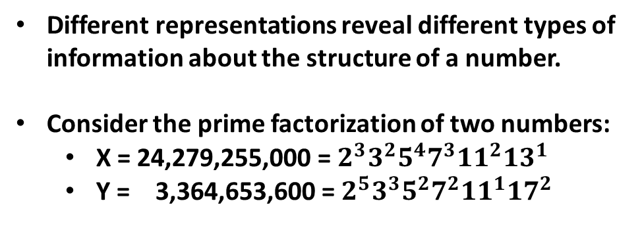
CRT is another way to represent integers
Different representations reveal different types of information about the structure of a number.
Consider the prime factorization of two numbers:
X = 24,279,255,000 = $2^{3}3^{2}5^{4}7^{3}{11}^{2}{13}^{1}$
Y = 3,364,653,600 = $2^{5}3^{3}5^{2}7^{2}{11}^{1}{17}^{2}$
INSERT
VIDEO
HERE

Slide 10
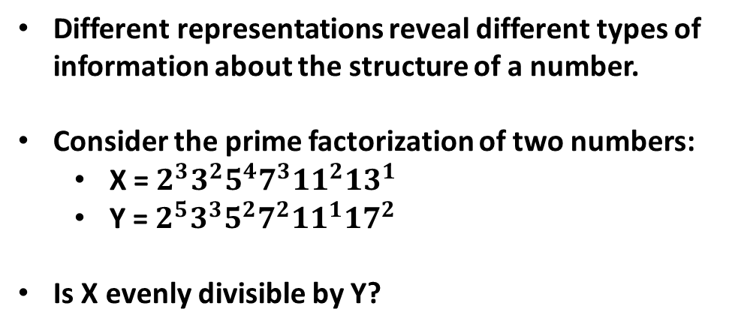
CRT is another way to represent integers
Different representations reveal different types of information about the structure of a number.
Consider the prime factorization of two numbers:
X = $2^{3}3^{2}5^{4}7^{3}{11}^{2}{13}^{1}$
Y = $2^{5}3^{3}5^{2}7^{2}{11}^{1}{17}^{2}$
Is X evenly divisible by Y?
INSERT
VIDEO
HERE

Slide 11
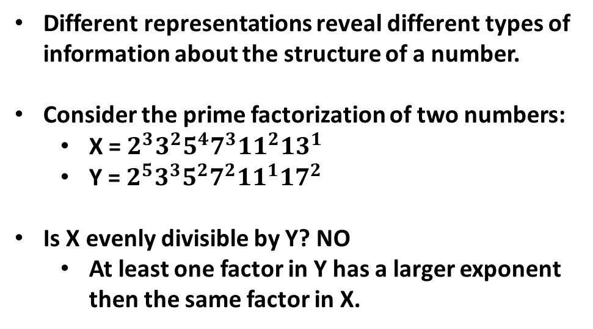
CRT is another way to represent integers
Different representations reveal different types of information about the structure of a number.
Consider the prime factorization of two numbers:
X = $2^{3}3^{2}5^{4}7^{3}{11}^{2}{13}^{1}$
Y = $2^{5}3^{3}5^{2}7^{2}{11}^{1}{17}^{2}$
Is X evenly divisible by Y? NO
At least one factor in Y has a larger exponent then the same factor in X.
INSERT
VIDEO
HERE

Slide 12
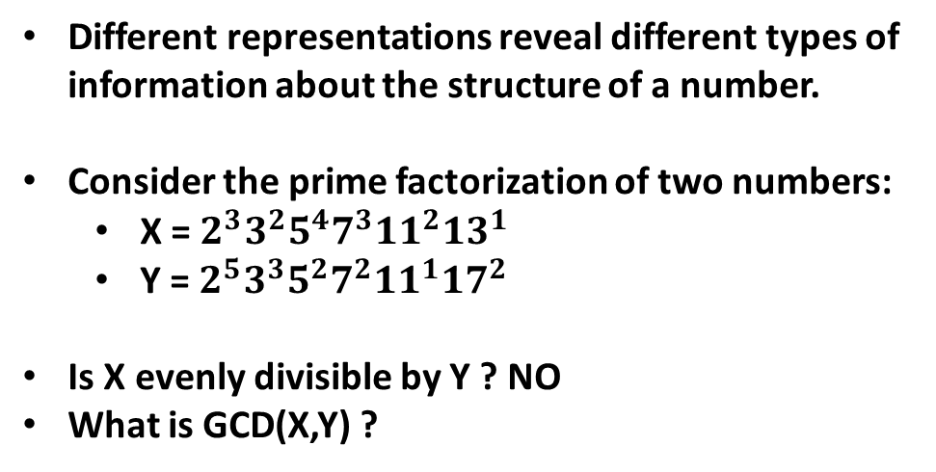
CRT is another way to represent integers
Different representations reveal different types of information about the structure of a number.
Consider the prime factorization of two numbers:
X = $2^{3}3^{2}5^{4}7^{3}{11}^{2}{13}^{1}$
Y = $2^{5}3^{3}5^{2}7^{2}{11}^{1}{17}^{2}$
Is X evenly divisible by Y ? NO
What is GCD(X,Y) ?
INSERT
VIDEO
HERE

Slide 13
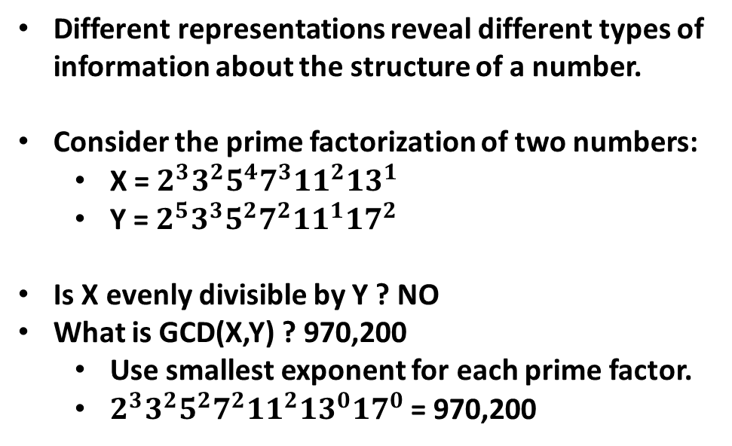
CRT is another way to represent integers
Different representations reveal different types of information about the structure of a number.
Consider the prime factorization of two numbers:
X = $2^{3}3^{2}5^{4}7^{3}{11}^{2}{13}^{1}$
Y = $2^{5}3^{3}5^{2}7^{2}{11}^{1}{17}^{2}$
Is X evenly divisible by Y ? NO
What is GCD(X,Y) ? 970,200
Use smallest exponent for each prime factor.
$2^{3}3^{2}5^{2}7^{2}{11}^{2}{13}^{0}{17}^{0}$= 970,200
INSERT
VIDEO
HERE

Slide 14
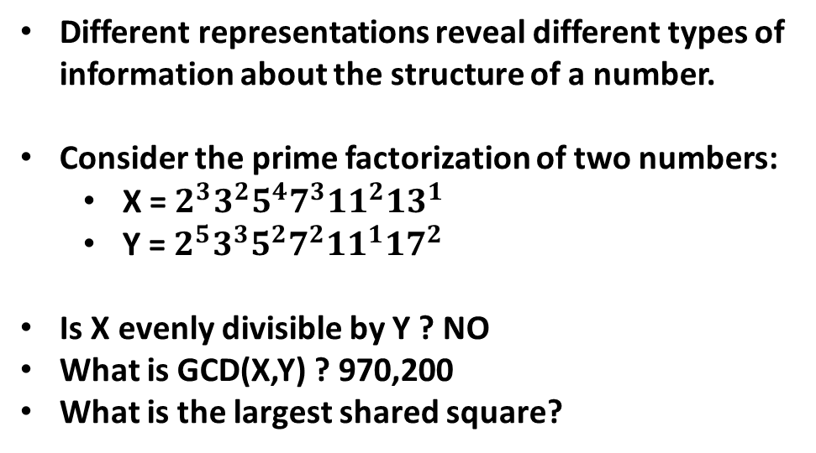
CRT is another way to represent integers
Different representations reveal different types of information about the structure of a number.
Consider the prime factorization of two numbers:
X = $2^{3}3^{2}5^{4}7^{3}{11}^{2}{13}^{1}$
Y = $2^{5}3^{3}5^{2}7^{2}{11}^{1}{17}^{2}$
Is X evenly divisible by Y ? NO
What is GCD(X,Y) ? 970,200
What is the largest shared square?
INSERT
VIDEO
HERE

Slide 15
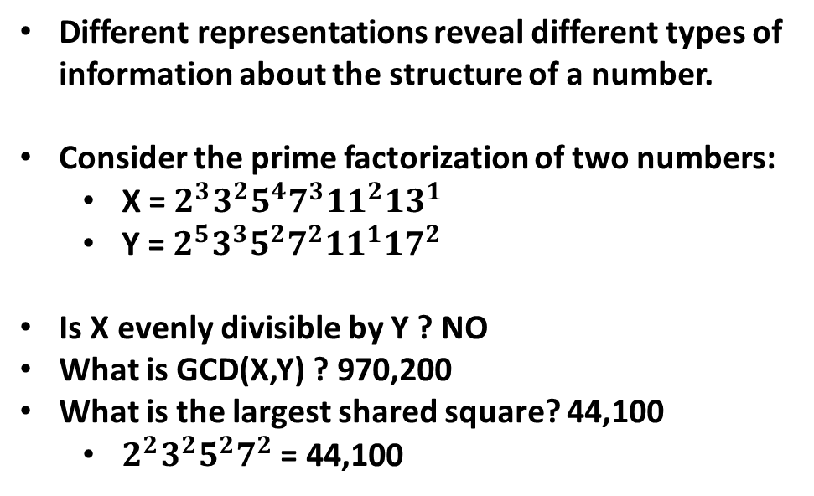
CRT is another way to represent integers
Different representations reveal different types of information about the structure of a number.
Consider the prime factorization of two numbers:
X = $2^{3}3^{2}5^{4}7^{3}{11}^{2}{13}^{1}$
Y = $2^{5}3^{3}5^{2}7^{2}{11}^{1}{17}^{2}$
Is X evenly divisible by Y ? NO
What is GCD(X,Y) ? 970,200
What is the largest shared square? 44,100
$2^{2}3^{2}5^{2}7^{2}$ = 44,100
INSERT
VIDEO
HERE

Slide 16
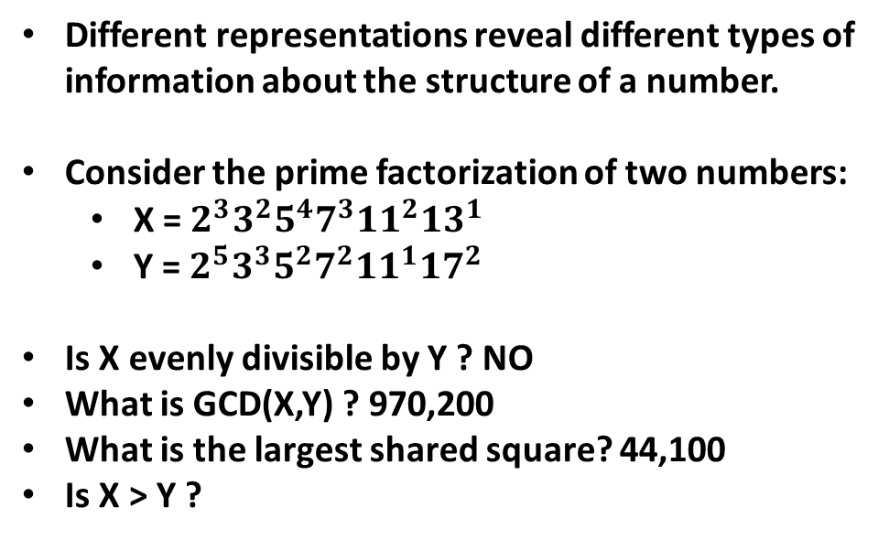
CRT is another way to represent integers
Different representations reveal different types of information about the structure of a number.
Consider the prime factorization of two numbers:
X = $2^{3}3^{2}5^{4}7^{3}{11}^{2}{13}^{1}$
Y = $2^{5}3^{3}5^{2}7^{2}{11}^{1}{17}^{2}$
Is X evenly divisible by Y ? NO
What is GCD(X,Y) ? 970,200
What is the largest shared square? 44,100
Is X > Y ?
INSERT
VIDEO
HERE

Slide 17
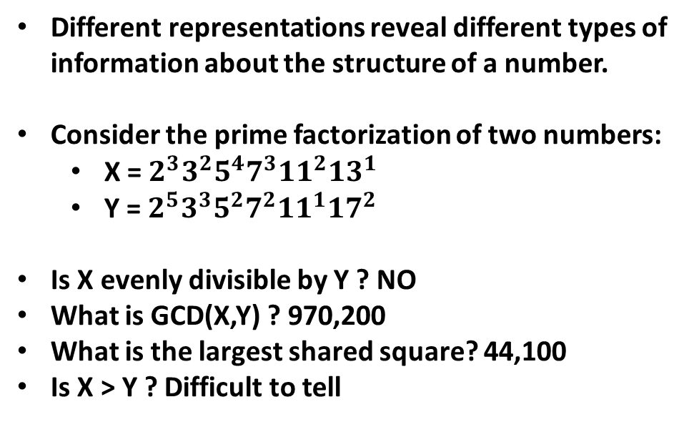
CRT is another way to represent integers
Different representations reveal different types of information about the structure of a number.
Consider the prime factorization of two numbers:
X = $2^{3}3^{2}5^{4}7^{3}{11}^{2}{13}^{1}$
Y = $2^{5}3^{3}5^{2}7^{2}{11}^{1}{17}^{2}$
Is X evenly divisible by Y ? NO
What is GCD(X,Y) ? 970,200
What is the largest shared square? 44,100
Is X > Y ? Difficult to tell
INSERT
VIDEO
HERE

Slide 18
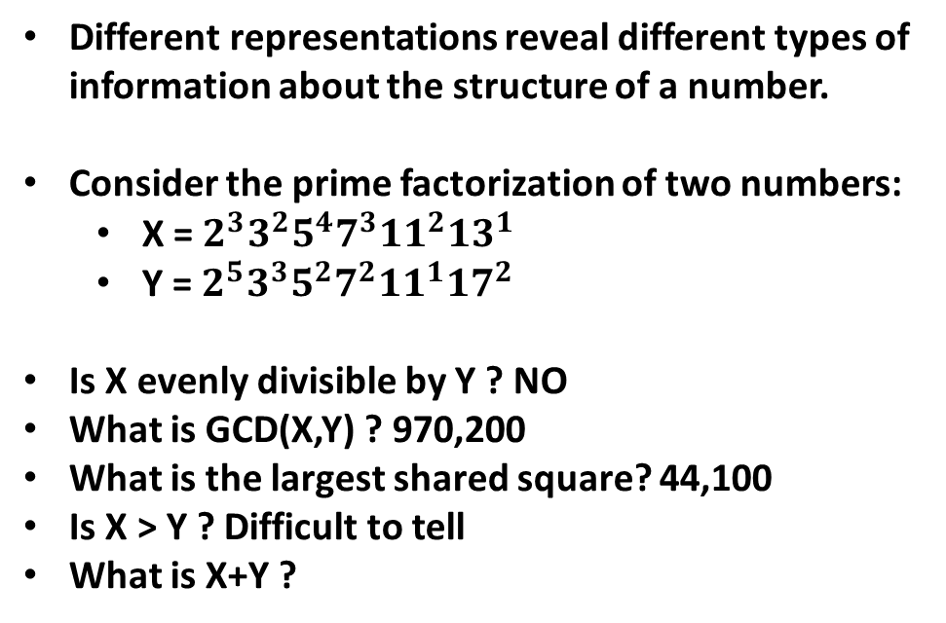
CRT is another way to represent integers
Different representations reveal different types of information about the structure of a number.
Consider the prime factorization of two numbers:
X = $2^{3}3^{2}5^{4}7^{3}{11}^{2}{13}^{1}$
Y = $2^{5}3^{3}5^{2}7^{2}{11}^{1}{17}^{2}$
Is X evenly divisible by Y ? NO
What is GCD(X,Y) ? 970,200
What is the largest shared square? 44,100
Is X > Y ? Difficult to tell
What is X+Y ?
INSERT
VIDEO
HERE

Slide 19
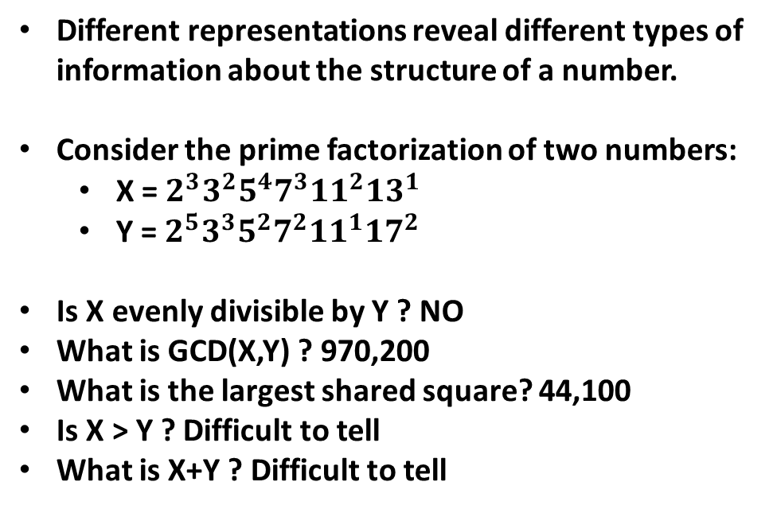
CRT is another way to represent integers
Different representations reveal different types of information about the structure of a number.
Consider the prime factorization of two numbers:
X = $2^{3}3^{2}5^{4}7^{3}{11}^{2}{13}^{1}$
Y = $2^{5}3^{3}5^{2}7^{2}{11}^{1}{17}^{2}$
Is X evenly divisible by Y ? NO
What is GCD(X,Y) ? 970,200
What is the largest shared square? 44,100
Is X > Y ? Difficult to tell
What is X+Y ? Difficult to tell
INSERT
VIDEO
HERE

Slide 20
Different representations are good
Prime factor representation is great for some things, not great for others.
INSERT
VIDEO
HERE

Slide 21
Different representations are good
Prime factor representation is great for some things, not great for others.
This is true for all representations – it’s why we have different representations in our toolbox.
INSERT
VIDEO
HERE

Slide 22
Different representations are good
Prime factor representation is great for some things, not great for others.
This is true for all representations – it’s why we have different representations in our toolbox.
The more representations we know how to use, the better able we are to choose a good one for the task at hand.
INSERT
VIDEO
HERE

Slide 23
Different representations are good
Prime factor representation is great for some things, not great for others.
This is true for all representations – it’s why we have different representations in our toolbox.
The more representations we know how to use, the better able we are to choose a good one for the task at hand.
CRT, like all representations, has strengths and weaknesses – we need to understand both in order to make use it effectively.
INSERT
VIDEO
HERE

Slide 24
What number am I thinking of?
X is a non-negative integer strictly less than 900.
The remainder when divided by 25 is 19
The remainder when divided by 9 is 7
The remainder when divided by 4 is 2
What is the number?
INSERT
VIDEO
HERE

Slide 25
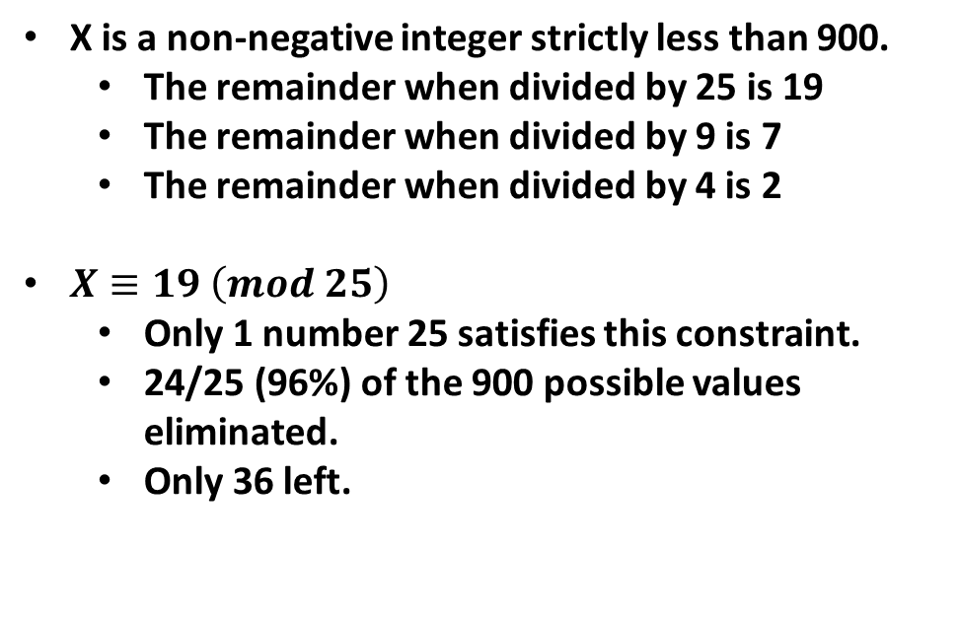
What number am I thinking of?
X is a non-negative integer strictly less than 900.
The remainder when divided by 25 is 19
The remainder when divided by 9 is 7
The remainder when divided by 4 is 2
$X≡19 \left(mod 25\right)$
Only 1 number 25 satisfies this constraint.
24/25 (96%) of the 900 possible values eliminated.
Only 36 left.
INSERT
VIDEO
HERE

Slide 26
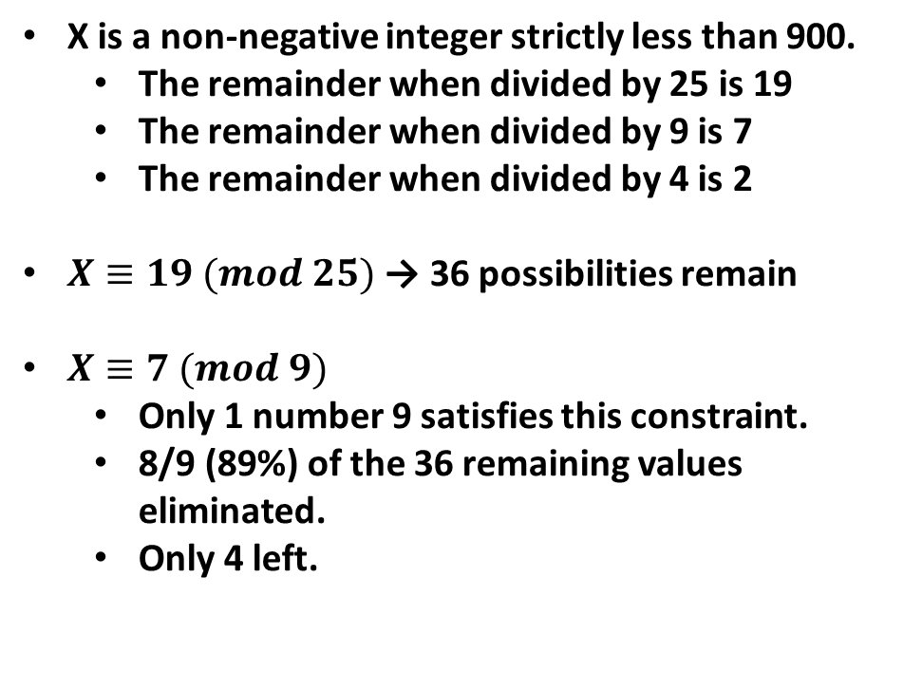
What number am I thinking of?
X is a non-negative integer strictly less than 900.
The remainder when divided by 25 is 19
The remainder when divided by 9 is 7
The remainder when divided by 4 is 2
$X≡19 (mod 25)$ → 36 possibilities remain
$X≡7 (mod 9)$
Only 1 number 9 satisfies this constraint.
8/9 (89%) of the 36 remaining values eliminated.
Only 4 left.
INSERT
VIDEO
HERE

Slide 27
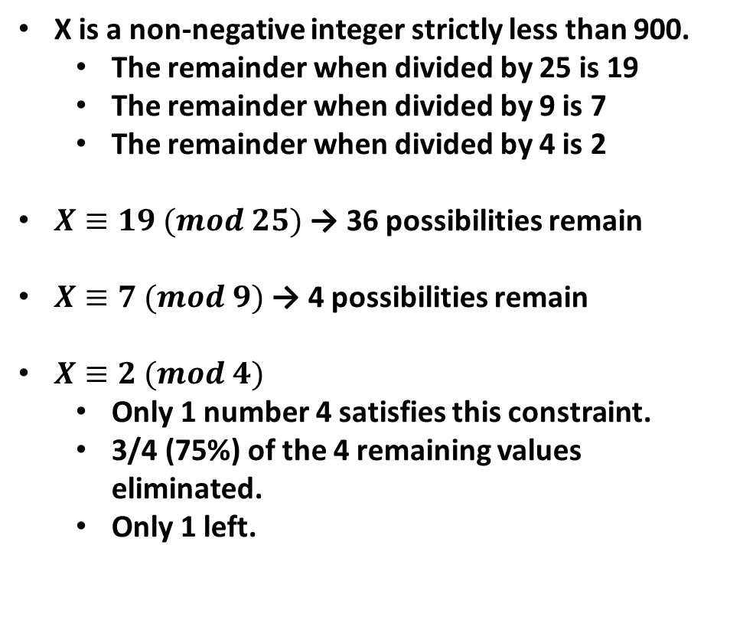
What number am I thinking of?
X is a non-negative integer strictly less than 900.
The remainder when divided by 25 is 19
The remainder when divided by 9 is 7
The remainder when divided by 4 is 2
$X≡19 (mod 25)$ → 36 possibilities remain
$X≡7 (mod 9)$ → 4 possibilities remain
$X≡2 (mod 4)$
Only 1 number 4 satisfies this constraint.
3/4 (75%) of the 4 remaining values eliminated.
Only 1 left.
INSERT
VIDEO
HERE

Slide 28
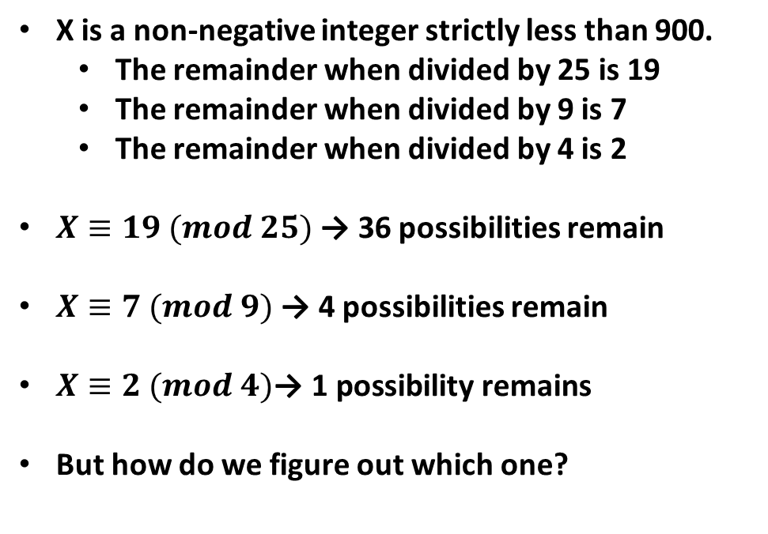
What number am I thinking of?
X is a non-negative integer strictly less than 900.
The remainder when divided by 25 is 19
The remainder when divided by 9 is 7
The remainder when divided by 4 is 2
$X≡19 (mod 25)$ → 36 possibilities remain
$X≡7 (mod 9)$ → 4 possibilities remain
$X≡2 (mod 4)\text{→ }\text{1} \text{possibility} \text{remains}$
But how do we figure out which one?
INSERT
VIDEO
HERE

Slide 29
What number am I thinking of?
X is a non-negative integer strictly less than 900.
The remainder when divided by 25 is 19
The remainder when divided by 9 is 7
The remainder when divided by 4 is 2
But how do we figure out which one?
Let’s come back to this after seeing how to represent a number using CRT.
INSERT
VIDEO
HERE

Slide 30
CRT representation is simply the residues of the selected moduli
INSERT
VIDEO
HERE

Slide 31
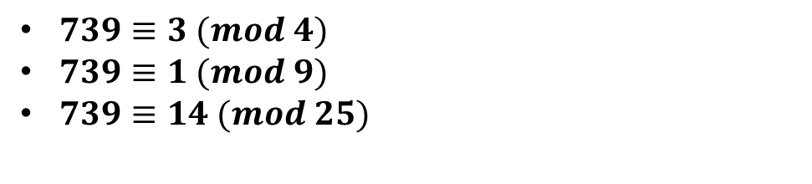
CRT representation is simply the residues of the selected moduli
$739≡3 (mod 4)$
$739≡1 (mod 9)$
$739≡14 (mod 25)$
INSERT
VIDEO
HERE

Slide 32
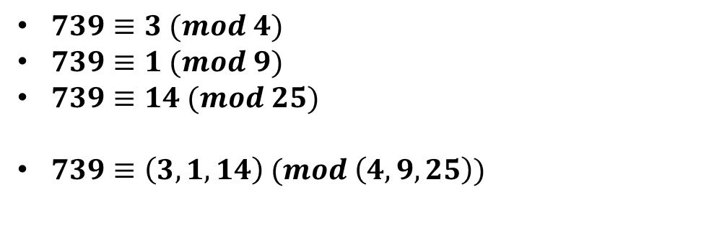
CRT representation is simply the residues of the selected moduli
$739≡3 (mod 4)$
$739≡1 (mod 9)$
$739≡14 (mod 25)$
$739≡\left(3,1,14\right) (mod \left(4,9,25\right))$
INSERT
VIDEO
HERE

Slide 33
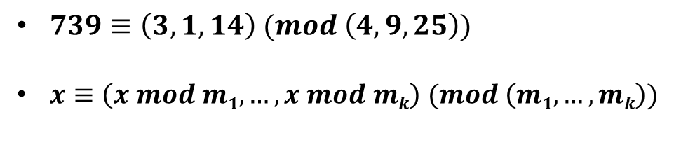
CRT representation is simply the residues of the selected moduli
$739≡\left(3,1,14\right) (mod \left(4,9,25\right))$
$x≡\left(x mod m1, …, x mod mk\right) (mod \left(m1,…,mk\right))$
INSERT
VIDEO
HERE

Slide 34
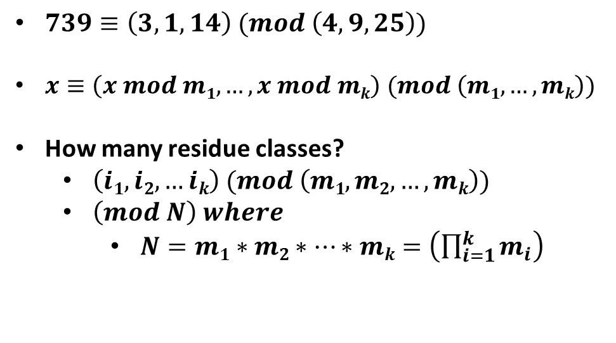
CRT representation is simply the residues of the selected moduli
$739≡\left(3,1,14\right) (mod \left(4,9,25\right))$
$x≡\left(x mod m1, …, x mod mk\right) (mod \left(m1,…,mk\right))$
How many residue classes?
$\left(i1,i2,…ik\right) (mod \left(m1,m2,…,mk\right))$
$\left(mod N\right) where$
$N=m1∗m2∗…∗mk=\left(\prod_{i=1}^{k}{m_{i}}\right)$
INSERT
VIDEO
HERE

Slide 35
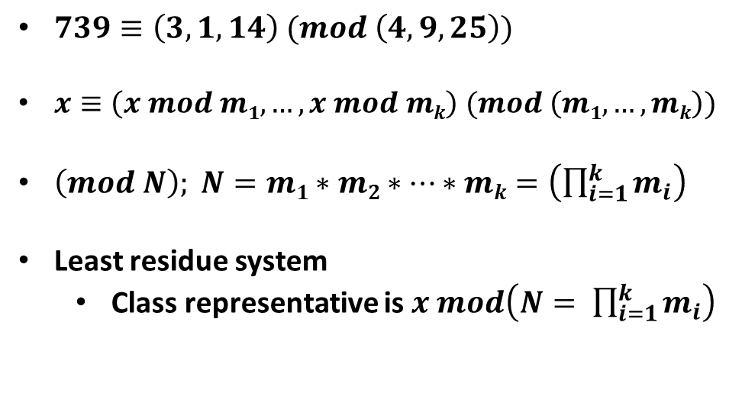
CRT representation is simply the residues of the selected moduli
$739≡\left(3,1,14\right) (mod \left(4,9,25\right))$
$x≡\left(x mod m1, …, x mod mk\right) (mod \left(m1,…,mk\right))$
$\left(mod N\right); N=m1∗m2∗…∗mk=\left(\prod_{i=1}^{k}{m_{i}}\right)$
Least residue system
Class representative is $x mod\left(N= \prod_{i=1}^{k}{m_{i}}\right)$
INSERT
VIDEO
HERE

Slide 36
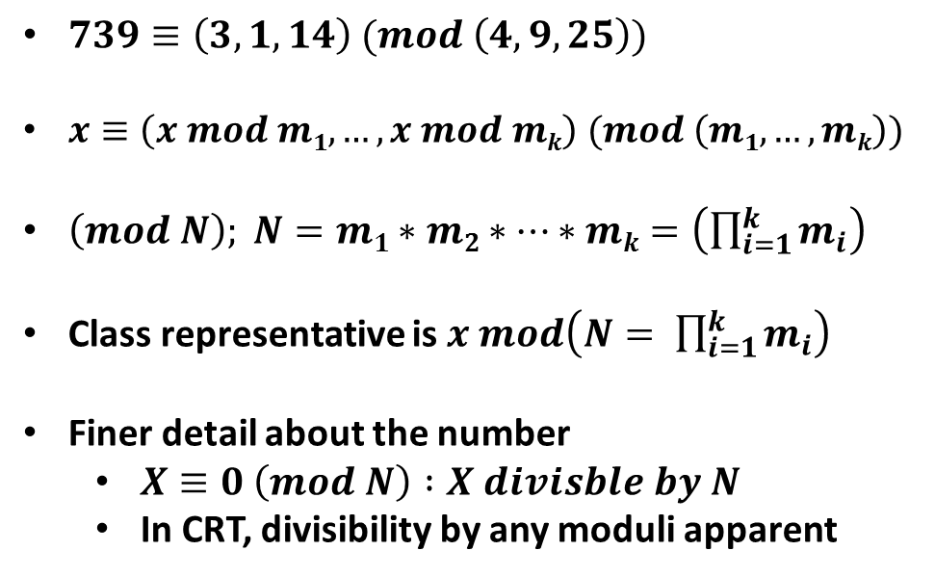
CRT representation is simply the residues of the selected moduli
$739≡\left(3,1,14\right) (mod \left(4,9,25\right))$
$x≡\left(x mod m1, …, x mod mk\right) (mod \left(m1,…,mk\right))$
$\left(mod N\right); N=m1∗m2∗…∗mk=\left(\prod_{i=1}^{k}{m_{i}}\right)$
Class representative is $x mod\left(N= \prod_{i=1}^{k}{m_{i}}\right)$
Finer detail about the number
$X≡0 \left(mod N\right) :X divisble by N$
In CRT, divisibility by any moduli apparent
INSERT
VIDEO
HERE

Slide 37
Lesson Review
IN THIS LESSON
INSERT
VIDEO
HERE

Slide 38
Lesson Review
IN THIS LESSON
Another representation of a mod-N world
INSERT
VIDEO
HERE

Slide 39
Lesson Review
IN THIS LESSON
Another representation of a mod-N world
Use a set of moduli whose product is N
INSERT
VIDEO
HERE

Slide 40
Lesson Review
IN THIS LESSON
Another representation of a mod-N world
Use a set of moduli whose product is N
Reduce X by each moduli in sequence
INSERT
VIDEO
HERE

Slide 41
Lesson Review
IN THIS LESSON
Another representation of a mod-N world
Use a set of moduli whose product is N
Reduce X by each moduli in sequence
Reveals finer detail about X
INSERT
VIDEO
HERE

Slide 42
Lesson Review
IN THIS LESSON
Another representation of a mod-N world
Use a set of moduli whose product is N
Reduce X by each moduli in sequence
Reveals finer detail about X
COMING UP
Restrictions on choice of moduli
INSERT
VIDEO
HERE

Slide 43
Lesson Review
IN THIS LESSON
Another representation of a mod-N world
Use a set of moduli whose product is N
Reduce X by each moduli in sequence
Reveals finer detail about X
COMING UP
Restrictions on choice of moduli
Converting from CRT to an integer
INSERT
VIDEO
HERE

Slide 44
Lesson Review
IN THIS LESSON
Another representation of a mod-N world
Use a set of moduli whose product is N
Reduce X by each moduli in sequence
Reveals finer detail about X
COMING UP
Restrictions on choice of moduli
Converting from CRT to an integer
What we can do with CRT
INSERT
VIDEO
HERE

Slide 45
Lesson Review
IN THIS LESSON
Another representation of a mod-N world
Use a set of moduli whose product is N
Reduce X by each moduli in sequence
Reveals finer detail about X
COMING UP
Restrictions on choice of moduli
Converting from CRT to an integer
What we can do with CRT
What we can’t do with CRT
INSERT
VIDEO
HERE

